Slide 1
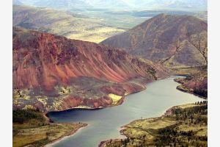



Heavy metals in the soil of some North Eastern Kazakhstan cities
Lecture by
Dr. M. Mizernaya

Slide 2
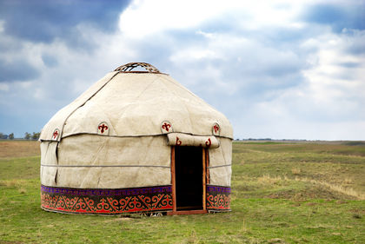
INTRODUCTION
Soil is the basis for agriculture. All vegetation for human food and animal feed depend upon soil.
The upper layer of the unsaturated zone of earth is the soil. Soil is the natural body made of mineral and organic constituents. It is produced by solid material recycling and complex processes of solid crust modifications. Soil offers shelter, habitat for numerous organisms and is the living medium for plants.

Slide 3
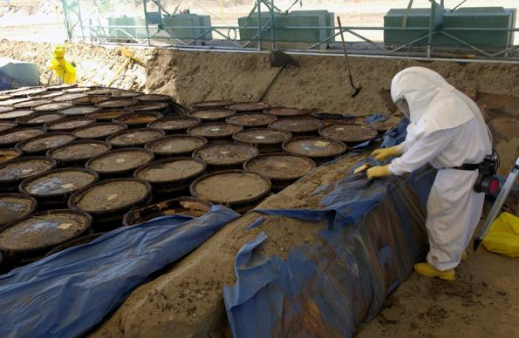
Enormous quantities of waste from man-made products are being released into the soil causing soil pollution. Polluted water also causes soil pollution. Soil pollution is caused due to unhygienic habits, agricultural practices and inappropriate methods of disposal of solid and liquid wastes. Soil pollution is a also caused as a result of atmospheric pollution.
1 WASTE AND SOIL POLLUTION

Slide 4
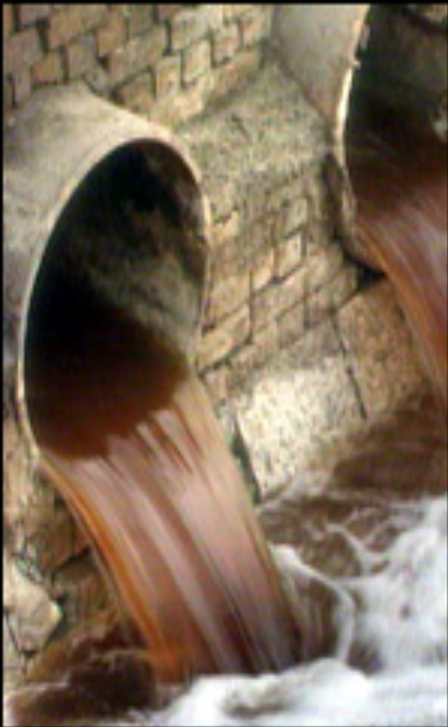
In industrialized countries, soil pollution is a result of use of chemicals in agriculture, dumping of waste materials, mining, smelting of metals and also dumping of domestic refuse and solids, untreated sewage and industrial wastes.

Slide 5
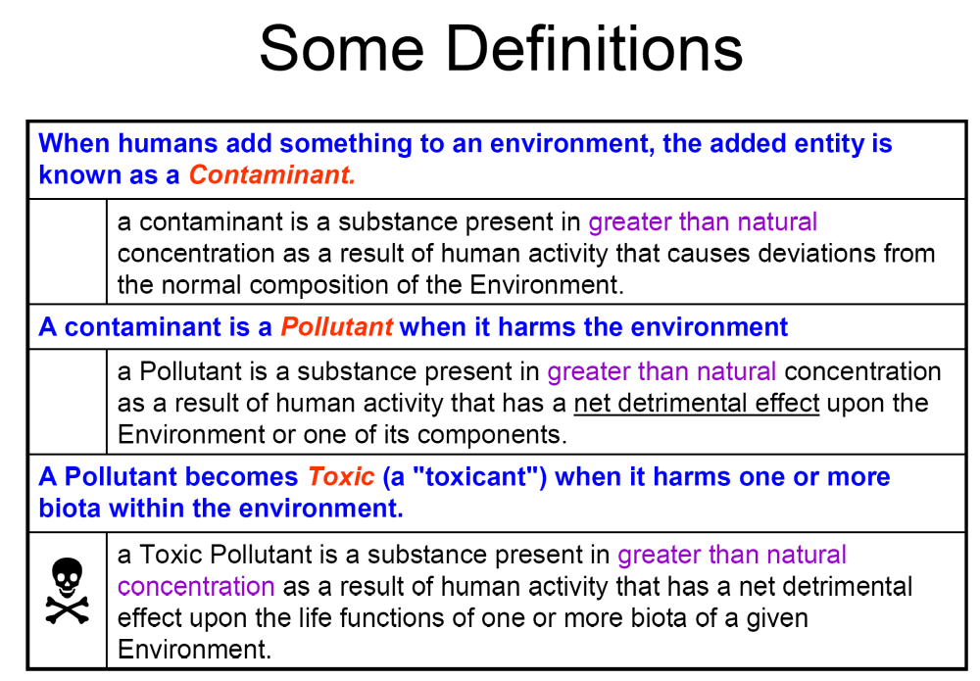
2 SOME DEFINITIOS

Slide 6
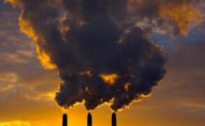
2 STUDING AND RESULTS
The aim of the present study is to determine the accumulation of the total contents and forms of the compounds of heavy metals in the soil of the major cities in the North-East of Kazakhstan, characterized by intensive technogenic impact on the environment.

Slide 7
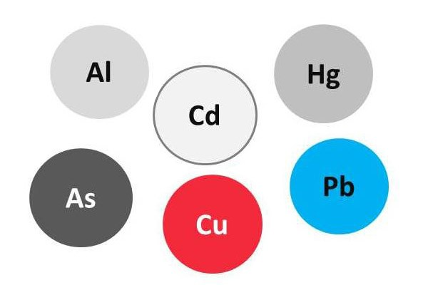
Four elements - copper, zinc, cadmium and lead were selected among the elements of the HM group. The reason for selection these elements was that soils of studied industrial regions mainly tend to technogenic areas of non-ferrous metals (lead and zinc, titanium, copper), chemical and other plants.

Slide 8

3 PHYSICAL AND CHEMICAL PROPERTIES OF SOILS IN UST-KAMENOGORSK, PAVLODAR AND SEMEY CITIES
In the real conditions of the city the accumulation of chemical elements in soils is very complex and is closely dependent not only on the degree of exposure of industrial, transport and municipal issues, but on a variety of factors:
- the physicochemical properties of the soil (pH, organics content,
- mechanical and mineralogical composition of the soil,
- the content of oxides and hydroxides of Al, Fe and Mn,
- salinity,
- cation exchange capacity and etc.

Slide 9
Table 1- Physico-chemical properties of soils in Ust-Kamenogorsk, Pavlodar, Semey sities
n | Sampling site | Ust-Kamenogorsk | Pavlodar | Semey
1 | рН | 5,7-8,4 | 6,2-8,2 | 7,0-8,6
2 | Total exchangeable bases, mEq/100 g of soil | 17,0-36,8 | 16,2-37,6 | 16,0-38,0
3 | Сorg, % | 1,8-2,8 | 1,5-2,5 | 2,1-4,3
4 | Р2О5, mg/100 g | 14,4-32,2 | 14,0-31,8 | 12,7-29,7
5 | К2О, mg/100 g | 35,0-68,0 | 34,0-66,8 | 33,4-67,7
6 | Hydrolyzed nitrogen, mg/100 g | 2,5-5,0 | 2,2-4,8 | 2,0-4,3
7 | The carbonate content, % | 0,6-2,2 | 0,2-1,4 | 0,4-2,0
8 | Physical clay, % | 4,4-28,6 | 6,2-18,7 | 5,0-30,3
9 | Sesqui oxide, % | 2,2-5,8 | 2,4-6,8 | 2,0-6,4
10 | EKO, mEq/100 g of soil | 5,8-14,4 | 5,0-16,6 | 6,4-18,5

Slide 10
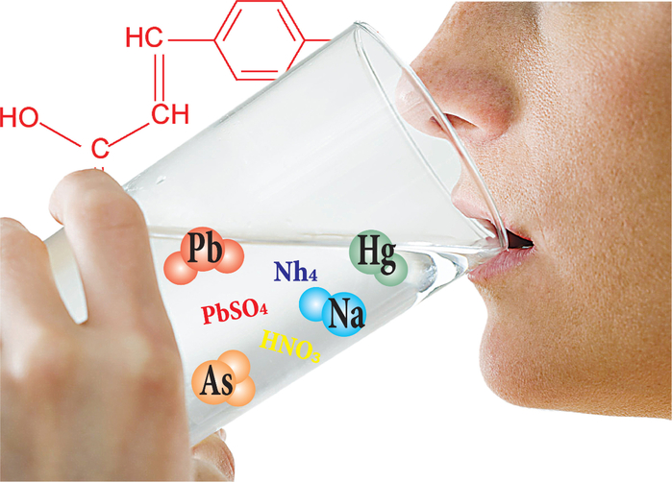
4 CONTENT AND THE CONTENT OF MOBILE FORMS OF HEAVY METALS IN SOILS OF UST-KAMENOGORSK, PAVLODAR AND SEMEY CITIES
The total content of metals provides an initial assessment of the state of urban soil, taking into account the regional background levels of these elements; its changes depending on granulometric composition, content of humus, soil reaction, the presence in soil-forming rock, geomorphological position of soil and other important factors.

Slide 11
Table 2. Variation-statistic indicators of total content of heavy metals in the soils of Ust-Kamenogorsk city (n = 350), mg/kg
Element | average number ± standard dispersion | margin of fluctuation | Ground (native data), mg/kg | MAC, mg/kg (Joint Order, 2004)
Zn | 847,02±5,2 | 103-4506 | 42,4 | 23
Cd | 9,01±1,3 | 0,27-29,73 | 0,36 | 0,5
Pb | 369,76±4,3 | 22,07-1351,77 | 15,7 | 32
Cu | 124,04±4,5 | 20-727,67 | 17,9 | 33
Thus, the total content (mg/kg) Zn in soils of Ust-Kamenogorsk ranges from 103 to 4506, Cd - from 0.27 to 29,73, Pb - from 22,07 to 1351,77, Cu - from 20 to 727.67 (Table 2). The average concentration of the chemical elements exceeds the background level of 6.9 (for copper) - to 25.0-times (for cadmium).

Slide 12
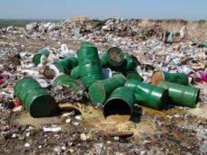
In general, the soils of Ust-Kamenogorsk city are characterized by cadmium-lead geochemical specialization: Cd69,3Pb23,1 Zn10,2Cu2,6.

Slide 13
Table 4. Variation-statistic indicators of total content of heavy metals in the soils of Pavlodar city (n = 441), mg/kg
Element | average number ± standard dispersion | margin of fluctuation | Ground (native data), mg/kg | MAC, mg/kg (Joint Order, 2004)
Zn | 156,1±4,1 | 43,2-547,8 | 42,4 | 23
Cd | 2,9±0,08 | 0,36-9,33 | 0,36 | 0,5
Pb | 66,7±1,5 | 17,9-199,6 | 15,7 | 32
Cu | 54,8±1,1 | 18,4-150,2 | 17,9 | 33
The magnitude of the gross average concentration (mg/kg soil) in soils of Pavlodar city investigated elements are arranged in the following descending order: Zn (156,1 ± 4,1)> Pb (66,7 ± 1,5)> Cu (54, 8 ± 1,1)> Cd (2,9 ± 0,08)

Slide 14
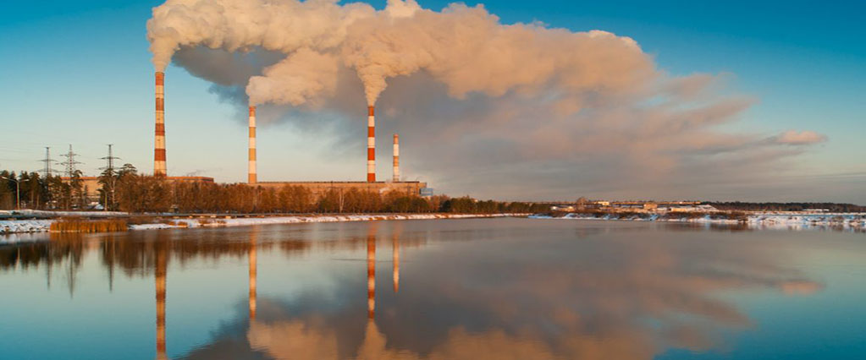

The average concentration of chemical elements in soils of Pavlodar city in 1,2-22,3 times higher than their Clarke in the Earth crust and in 2,7-6,7 times than their Clarke in the soil. In soils of the city from 20 to 75% of the samples containing various chemical elements exceeds their MAC. Most priority pollutant of soil of the city is cadmium. The average total rate of soil contamination throughout city of Pavlodar city is 16.1 and is characterized by moderate degree of pollution.
On average, soil of Pavlodar city is characterized by cadmium-lead geochemical specialization: Cd22,3Pb4, 2Zn1, 9Cu1,2.

Slide 15
Table 6. Variation-statistic indicators of heavy metals in soils of Semey city (n = 200),mg/kg
Element | average number ± standard dispersion | margin of fluctuation | Ground (native data), mg/kg | MAC, mg/kg (Joint Order, 2004)
Zn | 318,8±9,1 | 63,7-966,8 | 42,4 | 23
Cd | 3,4±0,1 | 0,5-12,36 | 0,2 | 0,5
Pb | 158,7±0,4 | 32,6-480,5 | 15,8 | 32
Cu | 74,6±1,9 | 28,8-281,3 | 19,5 | 33
Soils of Semey city are heavily contaminated by total content of zinc, lead, copper and cadmium. Zinc concentration exceeds 7.4 times, lead - 9.9 times, copper - 3.8 times and cadmium - 12.0 times - compared with the background of their content in
similar soils. The soils of the city are characterized by cadmium-lead specialization: Cd26,2Pb9,9Zn3,8 Cu1,6

Slide 16
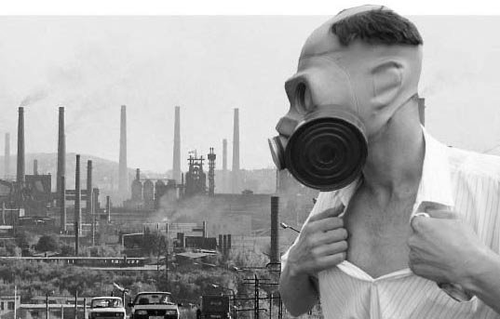
CONCLUSION
Geochemical specialization Ust-Kamenogorsk (Zc=72,5)> Semey (Zc=35,3)>Pavlodar (Zc=16,1). The level of total content and forms of chemical elements in soils of different areas of the city is not the same. Soils of industrialized congested areas of cities have a high degree of contamination, and in areas with a lack of industrial pollution sources – permissible contaminant level. The most concentration of heavy metals in the soil cover is determined by the direction of the prevailing winds and the distance from industrial centers

